Slide 1
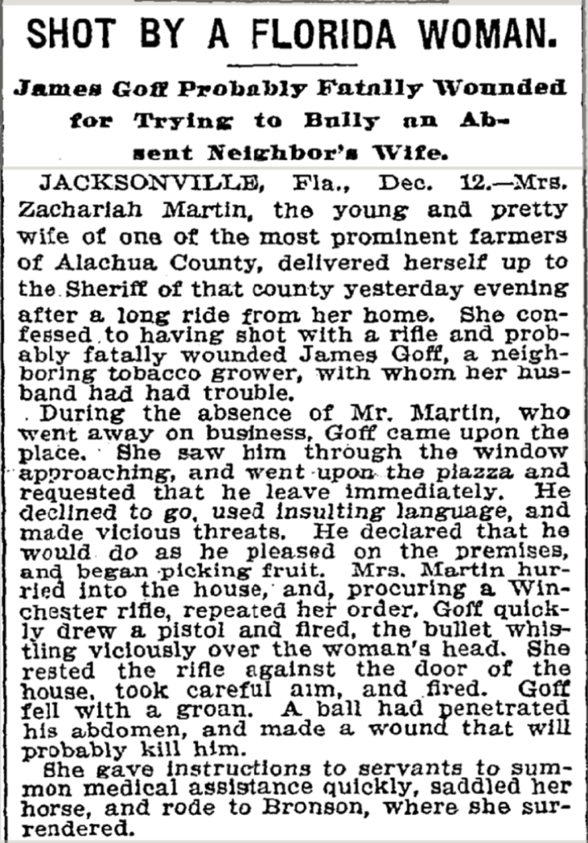
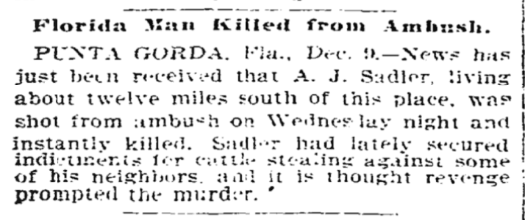
Florida Man
1897
1899
Team Members
Charles Lindner ✺ Lacy Williams
Alana Csaposs ✺ Bonnie-jo Barnaby
Notes:
Florida Fun Fact: “florida has more toll roads than any other state
Introduction by Alana: In this project, we decided to focus on the term “Florida Man.” If you haven’t heard, the phrase “Florida Man,” it’s seemed like a regular statement of news cycles, for wild stories about unusual crime. And this appears like it’s always been the case—these are the first two articles that reference “Florida Man” and “Florida Woman,” from 1899 and 1897 respectively. Both about wild antics involving murder and (probably) murder. (Both excellent reads if you have the time)

Slide 2
Motivation & Summary
Motivation:
We wanted something that wasn’t just numbers to challenge us to obtain data and sort through it. Additionally, we wanted to try and define who the “Florida Man” is and how public perception relates within the state of Florida and on a national level.
Hypothesis:
“Florida Man” is a recent phenomenon specific to both “Florida” and to “men,” and this phenomenon is presented in a negative light both locally and nationally.
Summary:
Our data analysis found that “Florida Man” is a phenomenon exclusive to “Florida” and to “men.” However, we found that it is not portrayed in a negative light nationally so much as it is locally.
Notes:
Florida Fun Fact: The small town of Pierson in Northeast Florida is known as the Fern Capital of the World. Ferns from farms here are shipped worldwide and these farms can be seen everywhere in the area.
Charles: How does someone or a group of some people decide that analyzing a very specific term is “a good Idea for a data analysis project. You may ask yourself. Fair Question we would reply. In fairness to one of our team, she was not present when we selected our project topic. Regardless, what we collectivfy want

Slide 3
Questions
How often is the “Florida Man” reported on nationally versus locally to Florida?
Is the “Florida Man” a more common character than the men of other states like “California Man?
What kinds of stories are being told about “Florida Man” and what are their subjects?
What percentage of the articles report crimes, both nationally and locally?
Is the “Florida Man” more popular than other genders and ages of Florida people? How does this data compare locally vs. nationally?
Are there certain years in the national news cycle where “Florida Man” was more common?
How often and what kinds of animals does “Florida Man” interact with?
Notes:
Florida Fun Fact: The highest point in Florida is only 345 feet above sea level. Britton Hill is in the Florida Panhandle. The highest point in Florida’s peninsula is Sugarloaf Mountain near Clermont at 312 feet.
Lacy: At the outset of our project, we wanted answers to the above questions. Does the phrase ‘Florida Man’ occur more frequently in national news than local news? Does national news run headlines featuring men from other states with similar frequency to Florida Man? ‘California Man’ for example? Does the phrase ‘California Man’ occur in California’s local news as frequently as ‘Florida Man’ does in Florida’s local news? What kind of stories are being published about Florida Man? What percentage of article report crime, both nationally and locally? What about other genders/demographics of Florida People, both nationally and locally? Does Florida Man appear consistently in national news? Or do we see him more in some years than others? What is Florida Man’s relationship with animals?

Slide 4
Data Exploration & Cleanup
Process
News Sources
New York Times (NYT) for national data and Accu News for local data. *Note: used Accu News for local data due to the lack of API’s in Florida news sources. Accu News API Call, NYT API Call
Globally
Defined fields needed for analysis for the API pulls (Title of article, summary of article, url for word analysis, date published, address/location and category [Florida Man, Florida Woman, etc.].
Within each API
Matched API data to predefined fields.
Local Files
Removed all records that were missing data. Completed a breakout of the address to obtain a column noting the State the article was reporting on. Removed all records for states that were not Florida. Filtered through files to extract keywords to further refine data to complete analysis. Cleanup Code
National Files
Removed all records that were missing data. Filtered NYT API results to only return title, summary, url, publication date, section & subsection. Added a column in the CSV file to include “State” in order to have a comparison point with the Local data files. Cleanup Code
Notes:
Florida Fun Fact: Florida has more golf courses than any other state and is home to the World Golf Hall of Fame and Museum in St. Augustine.
Charles:
After mapping out the project we started off exploring various news sources, USA today, NTY, Google News Service, Accu news and a host of others. Our initial Thought was to explore API’s from local publications in florida(tampa times) and compare the data we retrieved to National news sources (NTY). We encountered our first hurdle. 1. Local News Papers do not offer or host databases to call. And it was difficult to find any news sources that may be local to a place in florida. We eventually found Accu News and discovered we could specify long and lat coordinated and a radius search to fitter for local news sources. We futher refined data we recieved from that API by filter out for only Articles with a publish location Florida Address.
To obtain enough data we had to make about 2 dozen calles with our various Key Words and data point, like boy, girl, man, woman, and to make sure we weren’t rewriting code with every file to help with this we wrote code to selct the files were were using rather than retype them with every call.

Slide 5
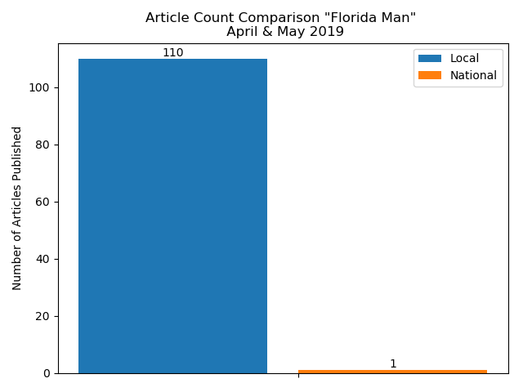
Question 1
How often is the “Florida Man” reported on nationally versus locally to Florida?
Purpose of Question:
We wanted to understand if the “Florida Man” is a national phenomenon in the same way that it may be a local phenomenon.
Data Used:
API pulls from Accu News and The New York Times. Data cleaned and exported to CSV files. Using Jupyter Notebook/Matplotlib created bar chart for visual representation.
Summary of Findings:
There were 99.99% “Florida Man” articles published locally than nationally in the New York Times.
*Due to Local API limits, we were only able to pull two months of data
Notes:
Florida Fun Fact: Florida’s largest river, the St. Johns River, is one of only a few major rivers that flow from south to north.
Bonnie-jo: To find out how frequently the “Florida Man” is reported on Nationally vs. Locally, we pulled our API’s, exported to CSV files and then using Jupyter Notebook, completed an article count for the months of April & May 2019. Due to API limits - we were only able to pull two months of data, which revealed that there were 110 Local articles published with only 1 National article written about “Florida Man” in the New York Times. In other words, there were 99.99% “Florida Man” articles published locally than nationally in the New York Times.

Slide 6
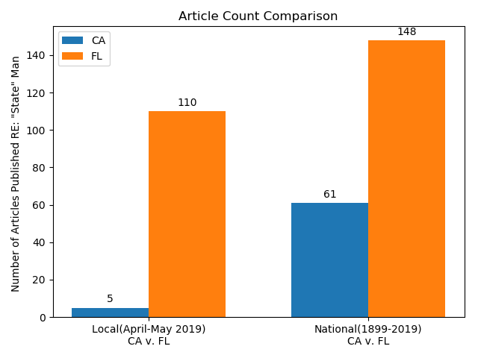
Question 1a
Is the “Florida Man” a more common character than the men of other states, like
“California Man”?
Purpose of Question:
We wanted to know if “Florida Man” is a Florida-specific occurrence, and if a state with a larger population would have more or less occurrences than Florida.
Data Used:
API pulls from Accu News and The New York Times. Data cleaned and exported to CSV files. Using Jupyter Notebook/Matplotlib created bar chart for visual representation.
Summary of Findings:
Locally there are 95% more articles published about Florida than California.
Nationally there are 59% more articles published about Florida than California.
Notes:
Florida Fun Fact: Florida is the largest producer of watermelons in the country. It also produces the most tomatoes, strawberries and sugar.
Bonnie-jo: In order to find out if “Florida Man” is a Florida-specific occurrence, we selected a state with a larger population - California - to see which “state” man is written about more frequently. Given more time to work on the project, we would complete a comparison with all “state” men to see what that information reveals. After completing the article counts we found that locally “Florida Man” is written about 95% more often than “California Man” and nationally there are 59% more articles published about “Florida Man” than “California Man”.

Slide 7
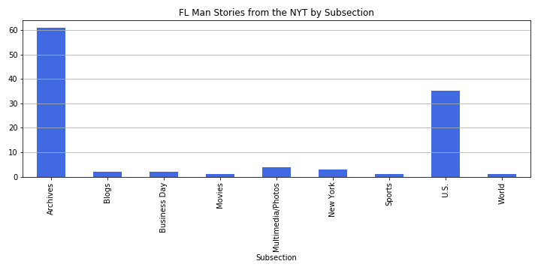
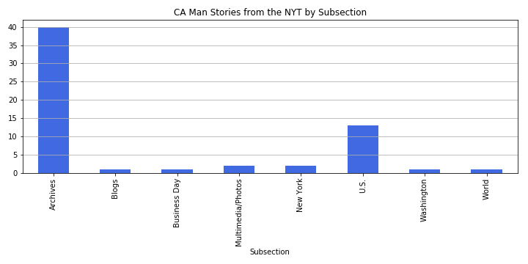
Question 2
What kinds of stories are being told about “Florida Man” and what are their subjects?
Purpose of Question:
Understanding how these stories are categorized would give us an idea about how national news recognizes “Florida Man” and other people from Florida.
Data Used:
API pulls from the New York Times. Data cleaned and exported to CSV files. Used Jupyter Notebook/Matplotlib created bar chart for visual representation from subsection information in NYT API call.
Summary of Findings:
There are more archived stories about “Florida Man” than “California Man”, as well as more US stories. There are stories about “Florida Man” in New York, almost exclusively about Florida men committing crimes in New York state.
Notes:
Florida Fun Fact: Made mostly of Florida pine, The Belleview Biltmore Resort and Spa, northwest of Tampa Bay is said to be the world’s largest occupied wooden structure at 820,000 square feet.
Alana: This question looks at specifically the NYT and its subsections—how are articles about “Florida Man” categorized by the publication. The subsections of NYT are not genre-specific, but do give an idea about some of the content of these articles. There are more archived stories about Florida Man than California Man, as well as more US stories—a funny thing to note is that there are stories about both in New York (which are often about ‘Florida Man’ being in New York and committing crimes…)

Slide 8
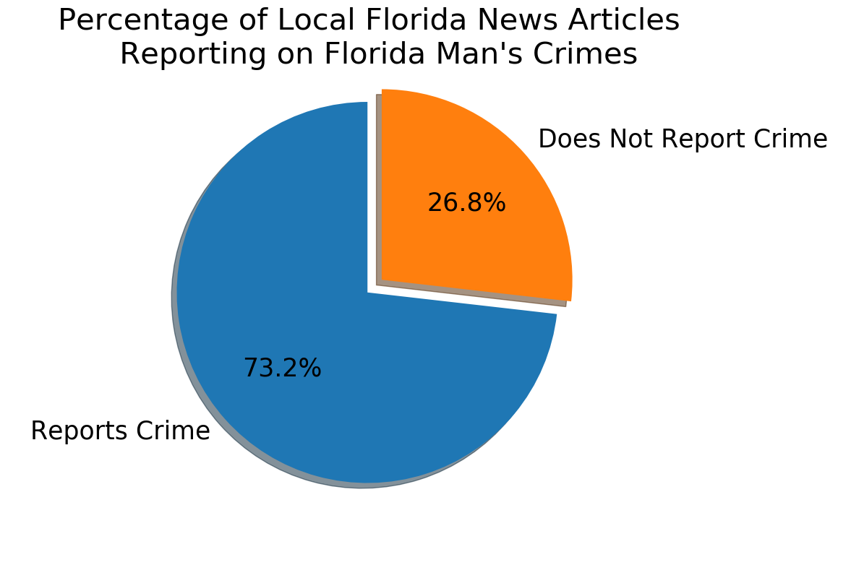
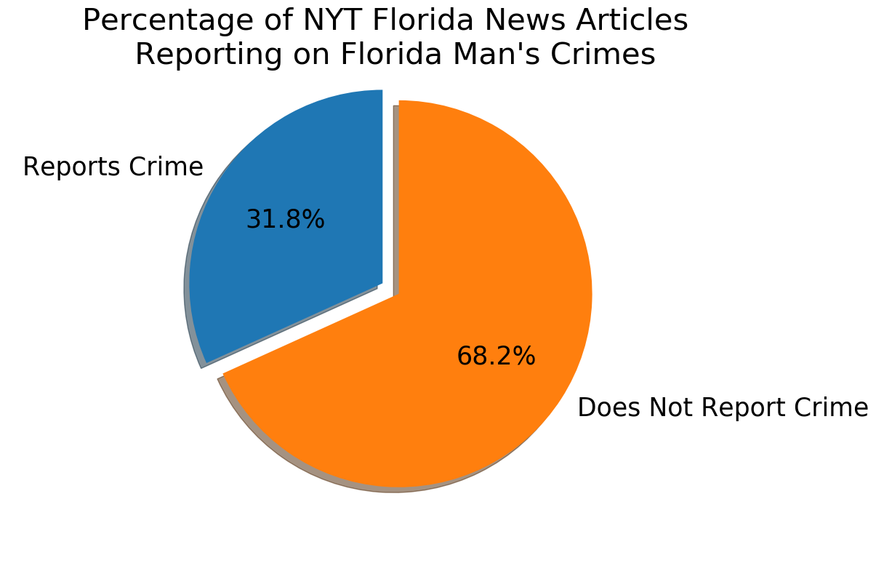
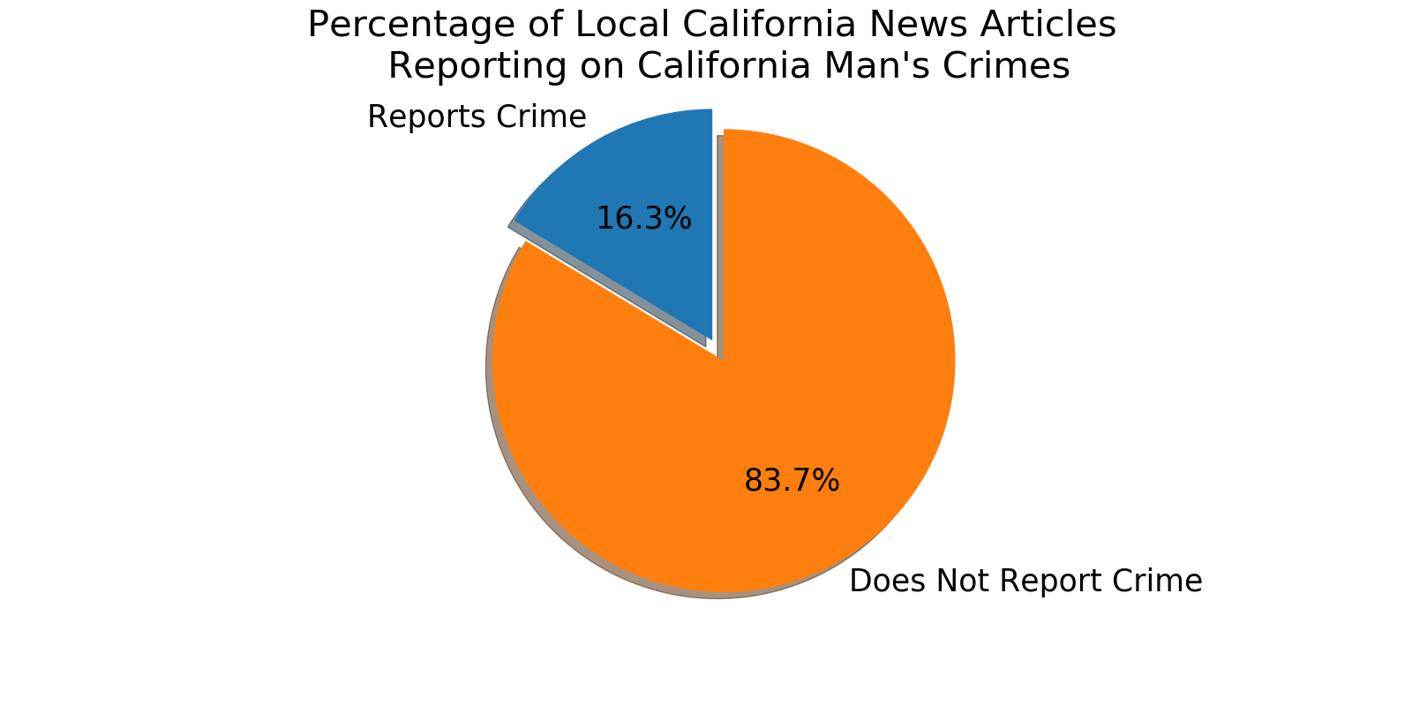
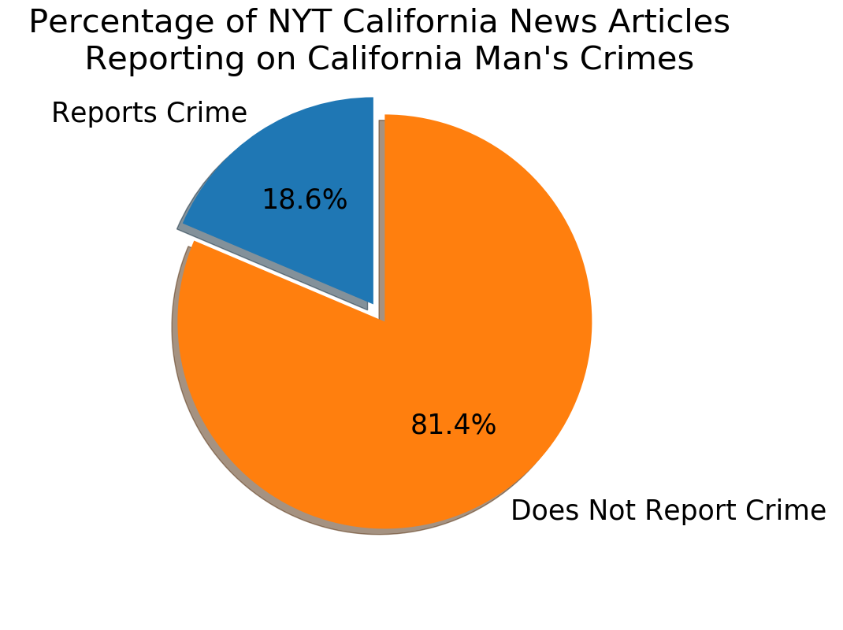
Question 3
What percentage of articles, both nationally and locally, report crime related to “Florida Man”? How does this compare to “California Man?
Purpose of Question:
We wanted to understand if the “Florida Man” is a national phenomenon in the same way that he may be a local phenomenon.
Data Used:
We used API pulls from Accu News and The New York Times. Data cleaned and exported to CSV files. Using Jupyter Notebook/Pandas/Matplotlib, we created four pie charts for visual representation.
Summary of Findings:
For both Florida and California, New York times articles we far less likely to report on crime than for local articles. This was not what we expected.
Notes:
Florida Fun Fact: You may be surprised to learn that in terms of area, Jacksonville, Florida is the largest city in the United States.
Lacy: After Bonnie-jo and Charles created CSV files of cleaned data, I imported the CSVs into data frames for analysis. I searched the data frame for several keywords related to crime and arrest. I then found the percentage of articles that contained crime keywords (dropping duplicates) and compared it to articles that did not. I was surprised to see that the most local articles about Florida Man reported crime. I expected to see Florida Man portrayed in a more generous manner locally than nationally. I thought national news would be attracted to salacious tales of Florida Man’s crimes and that would be reflected in the proportion of national stories about crime. However the trend I expected to see was reversed. National and local news about California had a similar proportion of articles about crime vs not crime.

Slide 9
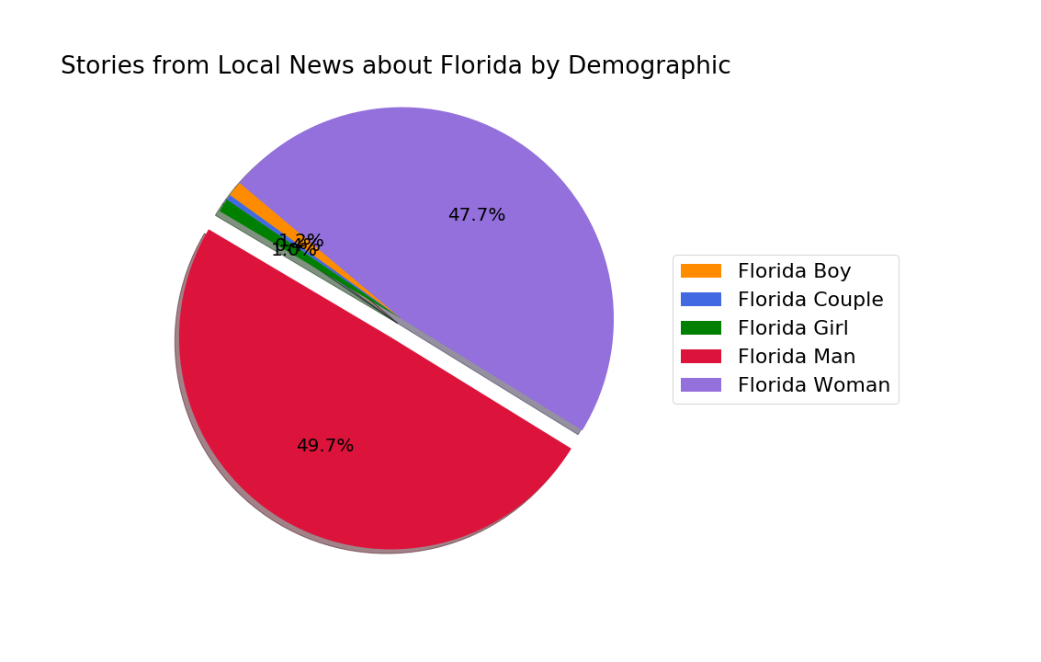
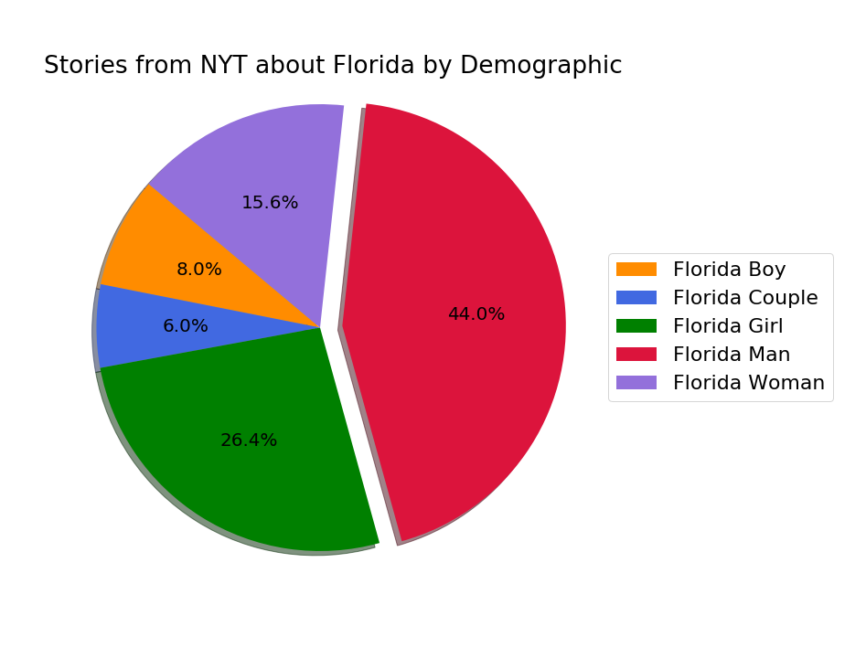
Question 4
Is the “Florida Man” more popular than other genders and ages of Florida people? How does this data compare locally vs. nationally?
Purpose of Question:
We wanted to know if “Florida Man” is exclusively a male phenomenon—and if that character of “Florida Man” is more recognized than other genders or ages.
Data Used:
API pulls from Accu News and The New York Times. Data cleaned and exported to CSV files. Using Jupyter Notebook/Matplotlib created pie chart for visual representation.
Summary of Findings:
There is a more even distribution of Florida stories by demographic nationally.
However, Florida Man is the most written about of all demographics—almost matched by Florida Woman locally.
Notes:
Florida Fun Fact: Sure there are long lines at Disney World. After all annual attendance is about 17 million people. That’s over 45,000 people per day on AVERAGE. Busy days will see over 100,000.
Alana: These pie charts are looking to see if “Florida Man” is a phenomenon specific to the gender/age of “men.” We compared this to headlines about “Florida Woman” “Girl” “Boy” and “Couple.” When we were looking into this, articles with gender-neutral language were negligible, and did not include them in this set (especially since girl/boy alone were so small). We found that “Florida Man” is overwhelmingly more popular than other demographics

Slide 10
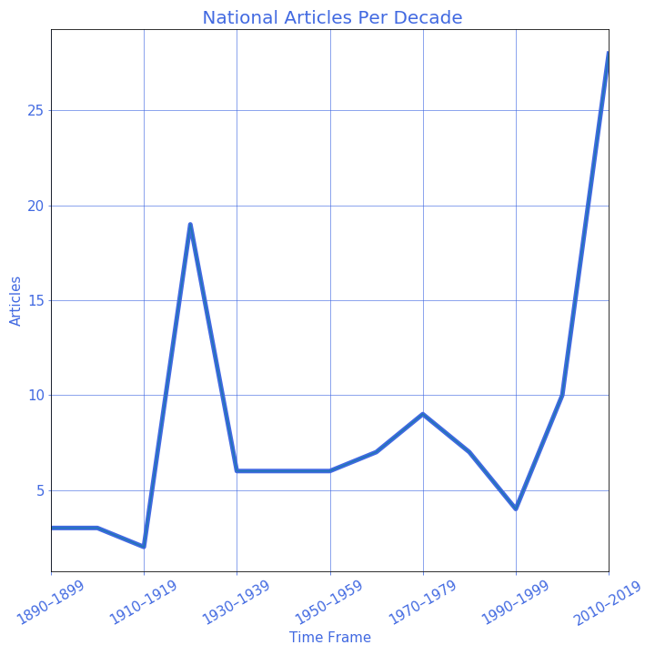
Question 5
Are there certain years in the national news cycle where “Florida Man” was more common?
Purpose of Question:
“Florida Man” feels like a recent turn of phrase—is that true?
Data Used:
API pull from The New York Times. Data cleaned and exported to CSV files. Using Jupyter Notebook/Matplotlib created line chart, binned by decade for visual representation.
Summary of Finding:
Around WWI there was a spike of references to Florida Man. Additional spikes happened around 2007 and another very sharp increase in 2007. Rise of clickbait increased instances of Florida man in the news cycle. Prior to 2007 article headlines contained the words “Florida Man”, after 2007 articles headlines started with “Florida Man”.
Notes:
Florida Fun Fact: It would make sense that mechanical refrigeration was invented in Florida. In 1851 Dr. John Gorrie of the little town of Apalachicola created the invention.
Charles: Over the 100 plus years we were able to Track Data for Florida Man we discovered a spike in the usage of terms for florida man. Fist in the period of the first world war. And again after 2007 into present day. For the present day an interesting part of the data is the headlines. For FLorida man Prior to 2007 the term florida man was in the title of an article,but was not he focus. After, 2007 FLorida Man is Exclusively the first two words in the headlines. The sources of article for florida man also shifted from print to online sources. We suspect the advent of Clickbait is a cause but at this time we can not confirm a correlation with our limited data. As for the spike during WWI.. A review of the stories listed shows florida was going through a economic boom so we would expect more articles about Florida Man.

Slide 11

Question 6
How often and what kinds of animals does “Florida Man” interact with?
Purpose of Question:
We often think of Florida Man stories including animals (we love animals). How often is this and which animals are more popular than others.
Data Used:
API pulls from Accu News and The New York Times. Data cleaned and exported to CSV files. We used Jupyter Notebook and Pandas to find no significant data.
Summary of Findings:
There was no significant data in either local or national news regarding alligators, cats, catfish, crocodiles, dogs, iguanas, lizards, opossums, panthers, raccoons, or turtles.
NO ANIMALS WERE HARMED IN THE MAKING OF THIS PRESENTATION!
Notes:
Florida Fun Fact: The Florida Everglades are the only place on the planet where crocodiles and alligators live together.
Lacy: I drafted a list of common Florida animals and found two articles about Florida Man’s interactions with animals. I did not believe that was enough data to make any conclusions about Florida Man’s relationship with animals.

Slide 12
Analysis Process
Github Project Link
The process was to divide the work into manageable steps:
Step One - Project determination
Step Two - Gather data
Step Three - Assign tasks to group members
Step Four - Preparation of Data
Step Five - Production of Graphs
Key points. We met almost every day outside of class to work on this project. Collaborated on every hardship and over-celebrated our triumphs. The bond we have forged will last the remainder of our lives we are now friends and family.
Notes:
Charles: Read the slide

Slide 13
Problem: Local news source API only provided last two months worth of data.
Resolution: Amended original plan to pull data for all of 2018.
Problem: Format of Local news API response came back as lists within dictionaries.
Resolution: The resolution for this issue began with sleeplessness, rapid weight loss, non-stop weeping followed by copious amounts of alcohol followed with a drunken session of successful code writing.
Problem: National news originally only pulled 10 records at a time.
Resolution: Creating looping within code to include additional page range for results and adding seven seconds interval between queries.
Problem: API calls had to be re-written for every file that had to be cleaned to account for different call criteria.
Resolution: Use Pandas/Jupyter Notebook to create input boxes allowing us to use the same code for multiple csv files. The library imported was “tkinter”.
Problems and Resolutions
Notes:
Bonnie-jo: During the project some of the problems we encountered were…..(Read the slide).

Slide 14
Insights
The perception that articles about “Florida Man” are more sensational, obscure or comical turned out not to be true. Our original idea of who “Florida Man” is does not exist outside stereotypes, at least according to our limited data sets
We expected to see more articles on ‘Florida Man’ nationally than locally. We believed that local articles would identify Florida man by his city or county, and not contain the headline ‘Florida Man’.
Surprisingly, there are more articles published locally than nationally that report on “Florida Man” crimes within the two month time frame we compared
Since California has a higher population than Florida, all other things being equal, one would expect to see more articles written about “California Man” the “Florida Man”. However that would not be the case if “Florida Man” was a genuine phenomenon.
Notes:
Lacy: Read the slide

Slide 15
Conclusion
While “Florida Man” has existed for over a century, our analysis revealed it is a recent stereotype exclusive to “Florida” and to “men.” However, we found that it is not portrayed in a negative light nationally so much as it is locally.
ITEM | TIMEFRAME | LOCAL | NATIONAL | CATEGORY
Number of Articles | 1897–2019 |  | 148
Number of Articles | April 2019–May 2019 | 110 | 1
Categories of Articles | 1897–2019 |  | 60+ 30+ < 10 each | Archive U.S. Other
Articles Reporting Crime | April 2019–May 2019 | 73.20%
Articles Reporting Crime | 1897–2019 |  | 31.80%
FL Man Comparison to Other Genders | April 2019–May 2019 | 49.70% |  | Man
FL Man Comparison to Other Genders | 1897–2019 | 44.00% |  | Man
Years Articles Were Popular | 1897–2019 |  | 1910–1915 2007–Present
Notes:
Alana: We found that “Florida Man” is a phenomenon exclusive to Florida, based on our analysis against California Man—although it has a larger population, the state name + man seems to be a Florida thing, both locally to those states and nationally in the NYT, seen in the charts made by Bonnie-jo and me. And looking at the demographic pie charts, we see that it is a phenomenon around “men.” And recent, based on Charles’s line graph.
In the case of a negative light, looking at the number of articles about crime, provided by Lacy’s charts, we see that crime is more focused on by local news as opposed to national news, something we didn’t expect. We suspect this happens because local news focuses on crime more actively overall, and will report on more types of crime (including smaller crimes)—and because of the limited industry in Florida, there is not as much other news to report.
This is all to say that “Florida Man” is very much a particular thing, and one that is recognized in the news—even if it’s not always negative.

Slide 16
Limitations
Availability of data:
1) Not a lot of free News Source data without a crap-ton of restrictions (like limiting timeframe, limiting # of calls, data that isn’t organized in easily searchable usable formats)
2) Variety of national sources was limited—we could only derive data from one news source
Not being able to afford to obtain more than two months of local articles—cost $500
Not being able to categorize local data due to no info regarding the section of paper the article was posted in
If we had two more weeks, we would:
1) Run Florida Man against every state nationally (instead of just California)
2) Search Local news by “county” man, “city” man
3) See how many involve animals with a larger dataset
4) Complete projections for what future data may show regarding number of articles, especially if we had more than two months of local data
Notes:
Bonnie-jo: Read the slide

Slide 17
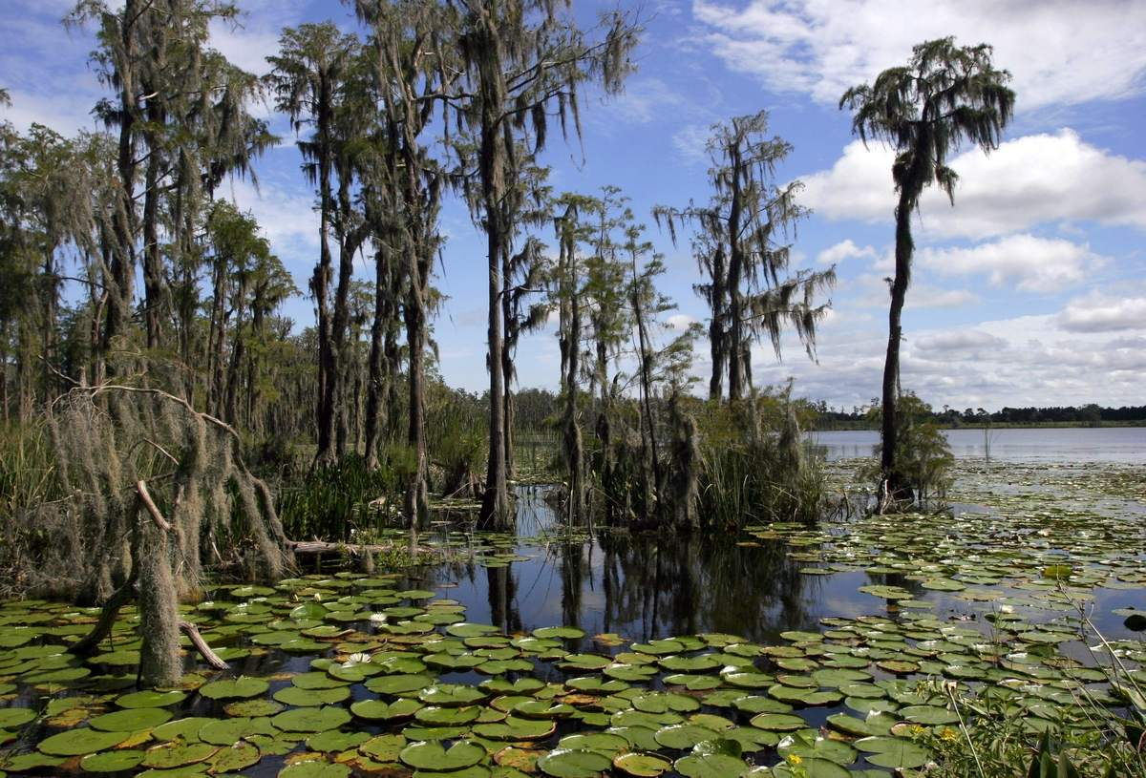
CLASS Q&A
Notes:
Florida Fun Fact: Main export is Oranges

